Slide 1


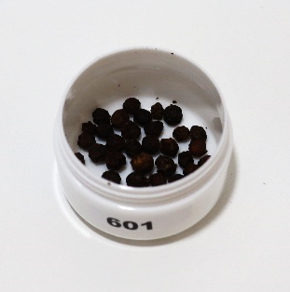
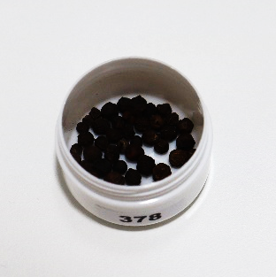
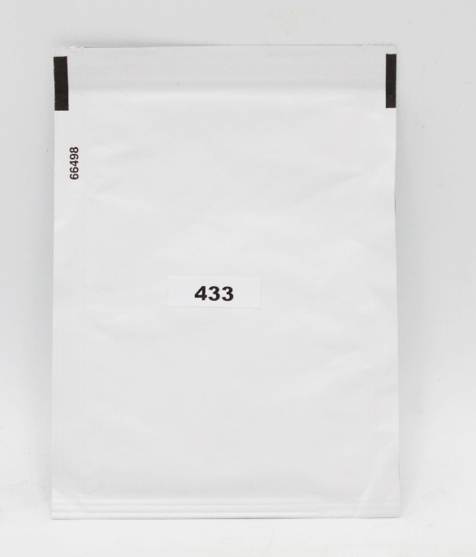
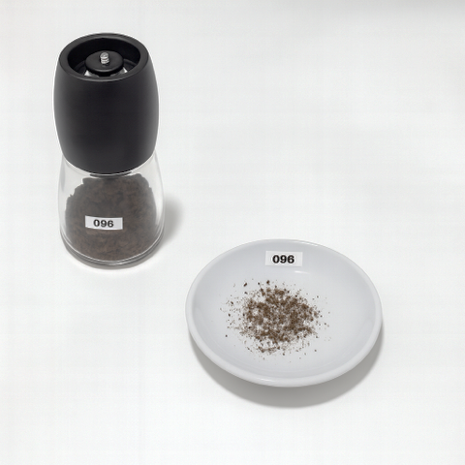
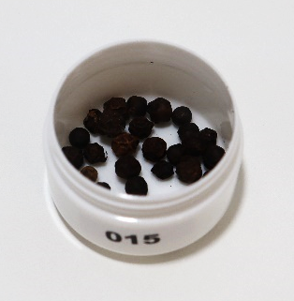
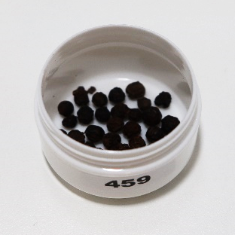










Impact of the manner of use on perceived odour profile of non-thermal plasma processed black pepper through a rate-all-that-apply (RATA) technique
${\text{Aline} \text{S}\text{ilva}}^{1,2,3}, { \text{C}\text{. }\text{R}\text{ocha}}^{1,3}, {\text{R}\text{. }\text{C}\text{. }\text{L}\text{ima}}^{1}, {\text{Y}\text{. }\text{Y}\text{ao}}^{2,4}, {\text{K}\text{. }\text{U}\text{jil}}^{5}, {\text{M}\text{. }\text{L}\text{inthorst}}^{5}\text{,} { \text{U}\text{. }\text{S}\text{chnabel}}^{4}$, ${\text{J}\text{. }\text{E}\text{hlbeck}}^{4},$
${{\text{K}\text{. }\text{A}\text{. }\text{A}\text{ndreas}}^{2}\text{, }\text{L}\text{. }\text{M}\text{ethven}}^{2}$, ${\text{L}. M. C\text{unha}}^{3∗}$
INTRODUCTION
RESULTS AND DISCUSSION
Black pepper is widely consumed but susceptible to microbial contamination during processing and storage (Rahman et al., 2021). Non-thermal plasma (NTP) offers a green, emerging technology to reduce contamination while maintaining quality. This study examines the impact of use method (whole, ground, freshly milled) and plasma processing time (0, 1, 10, 30 minutes) on the perceived odour profile and consumer liking.
For the whole type, the results showed that longer plasma processing (10 and 30 minutes) negatively impacted the overall liking when compared to 1 minute. For the ground and on-grinding types, there was no significant effect.
Table 3. Mean overall liking of black pepper samples with or without non-thermal plasma treatment and rated by consumers separated by their type
 | Travel control | Air Control | 1 min PPA | 10min PPA | 30 min PPA | P-value
Whole | 7.5±0.1^{a,b} | 7.4±0.1^{a,b} | 7.6±0.1ª | 7.3±0.1^{b} | 7.3±0.1^{b} | 0.031
Ground | 7.5±0.1 | 7.5±0.1 | 7.7±0.1 | 7.5±0.1 | 7.4±0.2 | 0.793
On-grinding | 7.7±0.1 | 7.7±0.1 | 7.6±0.1 | 7.6±0.1 | 7.6±0.1 | 0.726
METHODS
Odour profile was evaluated in four black peppercorns undergoing plasma processed air (PPA) (0 – air control, 1, 10 and 30 min) and the travel control treatment.
For each sample, consumers were asked to rate their overall liking on a 9-point hedonic scale (Peryam and Pilgrim, 1957) and assess the odour-related sensory (17 terms) attributes using a Rate-All-That-Apply (RATA) ballot (Ares et al., 2014).
The terms were pre-defined based on the team experience, a literature review, and a pilot test with black pepper samples.
The manner of use had a greater influence on consumer perception, with the on-grinding samples receiving the highest liking scores when compared to the whole peppercorns.
Table 4. Mean liking through RATA analysis of black pepper of different types.
 | Whole | Ground | On-grinding | P-value
Overall liking | 7.4±0.1 ^{b} | 7.5±0.1 ^{a,b} | 7.6.±0.1 ª | 0.003
The on-grinding sample exhibits attributes such as balsamic, floral, fresh, black pepper, and spicy, which are typically associated with positive sensory perceptions and align closely with overall liking.
The whole sample is characterised by earthy and woody notes, while the ground sample is associated with more herbal and green descriptors, such as herbaceous/fresh grass, citric, fresh pine, and aniseed/fennel.
N=75
Session 1
Session 2
Session 3
Whole
Ground
On-grinding
49±11
years old
61%
39%
Participants were invited to evaluate the samples in three different sessions, evaluating three ways of using the pepper: whole, ground and on-grinding.
Animal/Stable (Animal/estábulo);
Balsamic (Balsâmico);
Wood oil/Cedar (Óleo de madeira/Cedro);
Citric (Cítrico);
Aniseed/Fennel (Anis/Funcho);
Earthy (Terroso);
Floral (Floral);
Fresh (Fresco);
Woody (Amadeirado);
Fresh pine (Pinho fresco);
Smoke/ash (Fumo/Cinza);
Herbaceous/Fresh herb (Herbácio/Erva fresca);
Pungent/Irritating (Pungente/Irritante);
Humidity (Humidade);
Old wardrobe (Armário velho);
Black pepper (A pimento preta);
Spices (Especiarias).
Figure 2. Biplots with dimensions 1 and 2 of correspondence analysis (CA) of RATA (Rate-All-That-Apply) data from the sensory profiling of black pepper. The CA was performed on the sum of scores given by all consumers to each term, describing each sample (RATA scoring). Sensory attributes ordered by sensory dimension: O – odour.
Table 1. Attribute list for black pepper
¹ Sense Test, Rua Zeferino Costa, 341, 4400-345 Vila Nova de Gaia, Portugal
² Department of Food and Nutritional Sciences, Harry Nursten Building, University of Reading, Whiteknights, Reading RG6 6DZ, UK
³ GreenUPorto /Inov4Agro, DGAOT, Faculty of Sciences, University of Porto Rua da Agrária 747, 4485-646 Vila do Conde, Portugal
⁴ Leibniz Institute for Plasma Science and Technology (INP), Greifswald, Germany
⁵ Koninklijke Euroma B.V., Zwolle, the Netherlands
*Corresponding author: lmcunha@fc.up.pt
CONCLUSION
Results enhance the applicability of non-thermal plasma for decontaminating spices while preserving their gastronomic profile. Showing that the manner of use has a more substantial impact on odour perception than short plasma treatment. Freshly milled pepper is preferred for its fresh and aromatic profile. These results support the feasibility of using non-thermal plasma for decontaminating spices without compromising sensory quality.
References
Acknowledgments
Ares, G., & Jaeger, S. R. (2013). Check-all-that-apply questions: Influence of attribute order on sensory product characterization. Food Quality and Preference, 28(1), 141-153 https://doi.org/10.1016/j.foodqual.2012.08.016
Peryam, D. R., & Pilgrim, F. J. (1957). Hedonic scale method of measuring food preferences. Food technology, 11(1), 9-14
Rahman, M., Islam, M. A., Das, K. C., Salimullah, M., Mollah, M. Z. I., & Khan, R. A. (2021). Effect of gamma radiation on microbial load, physico-chemical and sensory characteristics of common spices for storage. Journal of Food Science and Technology, 58(9), 3579-3588..
This project has received funding from the European Union’s Horizon 2020 research and innovation programme under the Marie Skłodowska-Curie grant agreement No 955431 (Transit).
Authors Silva, Ribeiro, Rocha and Cunha acknowledge support from Fundação para a Ciência e a Tecnologia (FCT), through the Strategic Projects UIDB/05748/2020 - doi: 10.54499/UIDB/05748/2020 and UIDP/05748/2020 - doi: 10.54499/UIDP/05748/2020 (GreenUPorto).

